Slide 1

Information
Deck

Slide 2


About ROYCE
We come with an experience of about 35 years in lighting business. Royce started out as a lighting store in the neighborhood and today it is catering all sorts of requirement for Industrial, commercial and residential clients
We provide countless options ranging from classic chandeliers to contemporary shades and LED bulbs, we help find exactly what one is looking for.
Royce is also into manufacturing of etched and UV printed glass, LED mirrors using ultra modern technology and smart home systems for your home security.
Our group company Royce furnishing has a wide range of furnishing products for Hotels, Motels, resorts etc. comprising of both hard and soft furnishing, crockery, cutlery, linen, amenities.
Royce Signs exclusively manufactures signages of various sizes, quality, material both indoor and outdoor.
Our approach is to demonstrate with practicality how solutions shine through. The philosophy includes practical solutions, professional training and personalized service.
We believe in making good things happen, the way you want.
We enjoy helping our customers find the perfect solution for desired style and budget.
We are truthful and transparent in our interactions with customers.
ROYCE Lighting
ROYCE Furnishing
ROYCE Global Technologies
ROYCE Signs
Elegante Glass

Slide 3

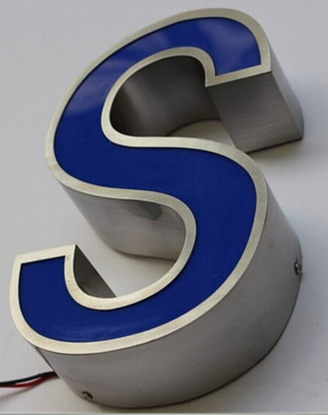
Signages
OUTDOOR

Slide 4

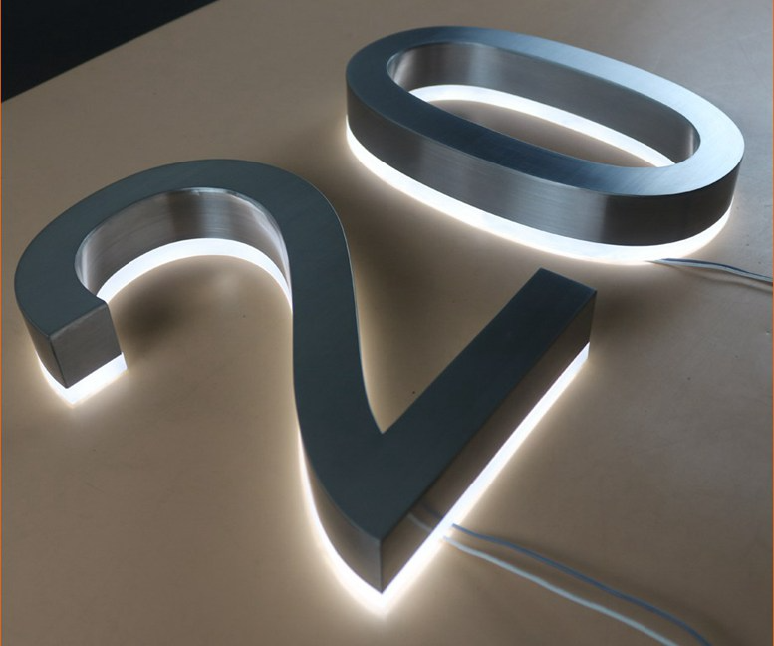
Signages
OUTDOOR

Slide 5
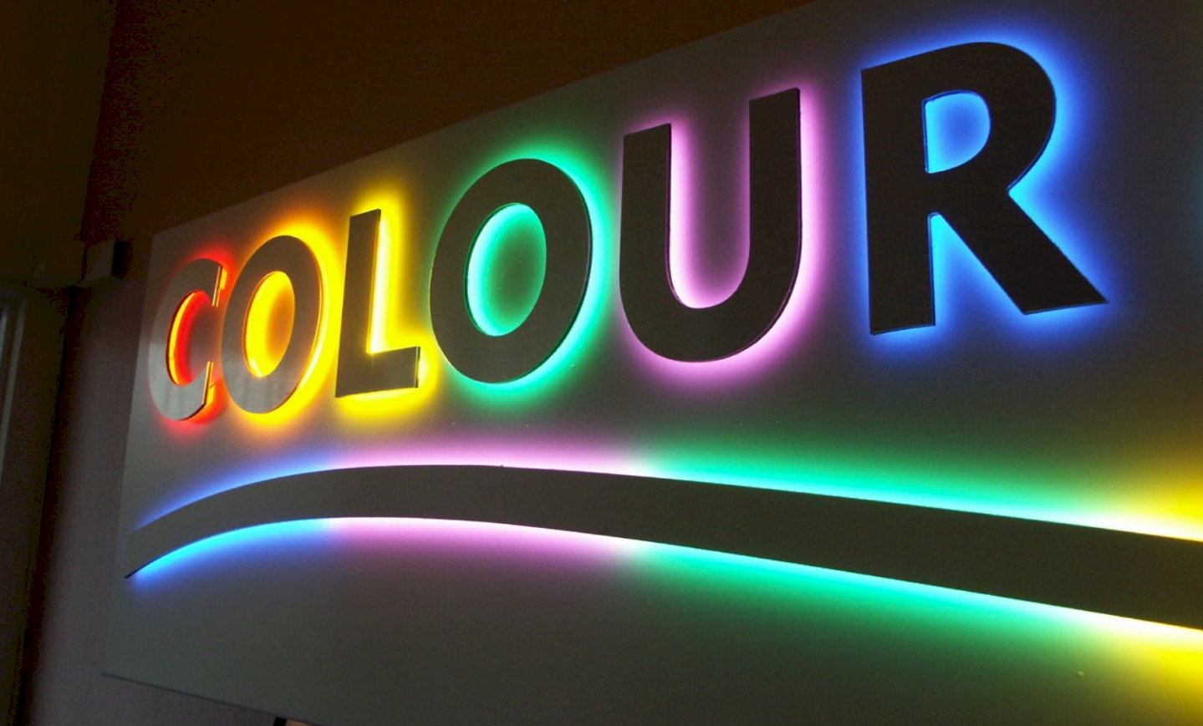

Signages
OUTDOOR

Slide 6
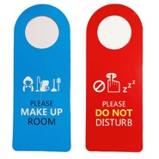
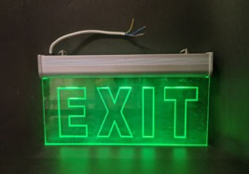
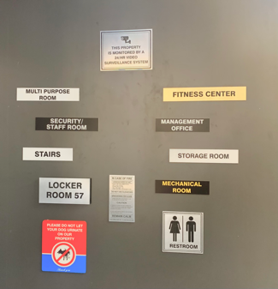
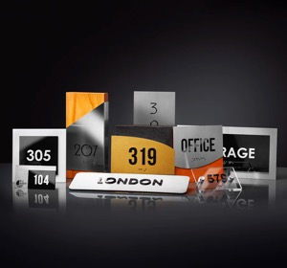
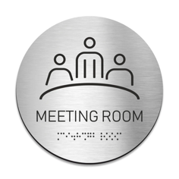
Signages
INDOOR

Slide 7



CLIENTS

Slide 8
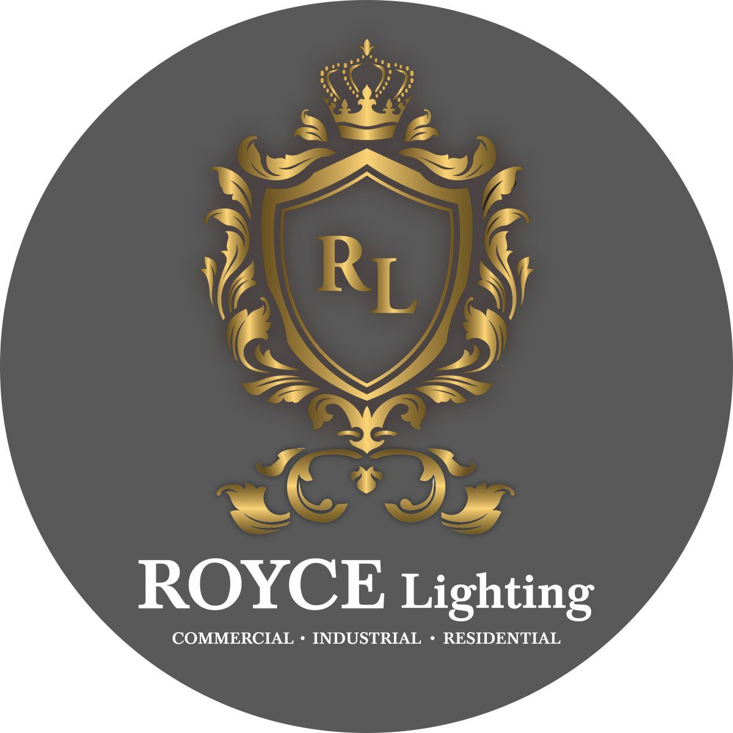
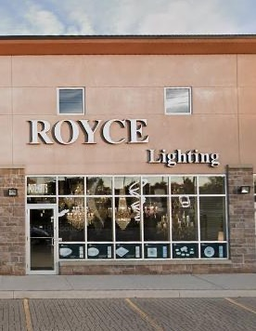
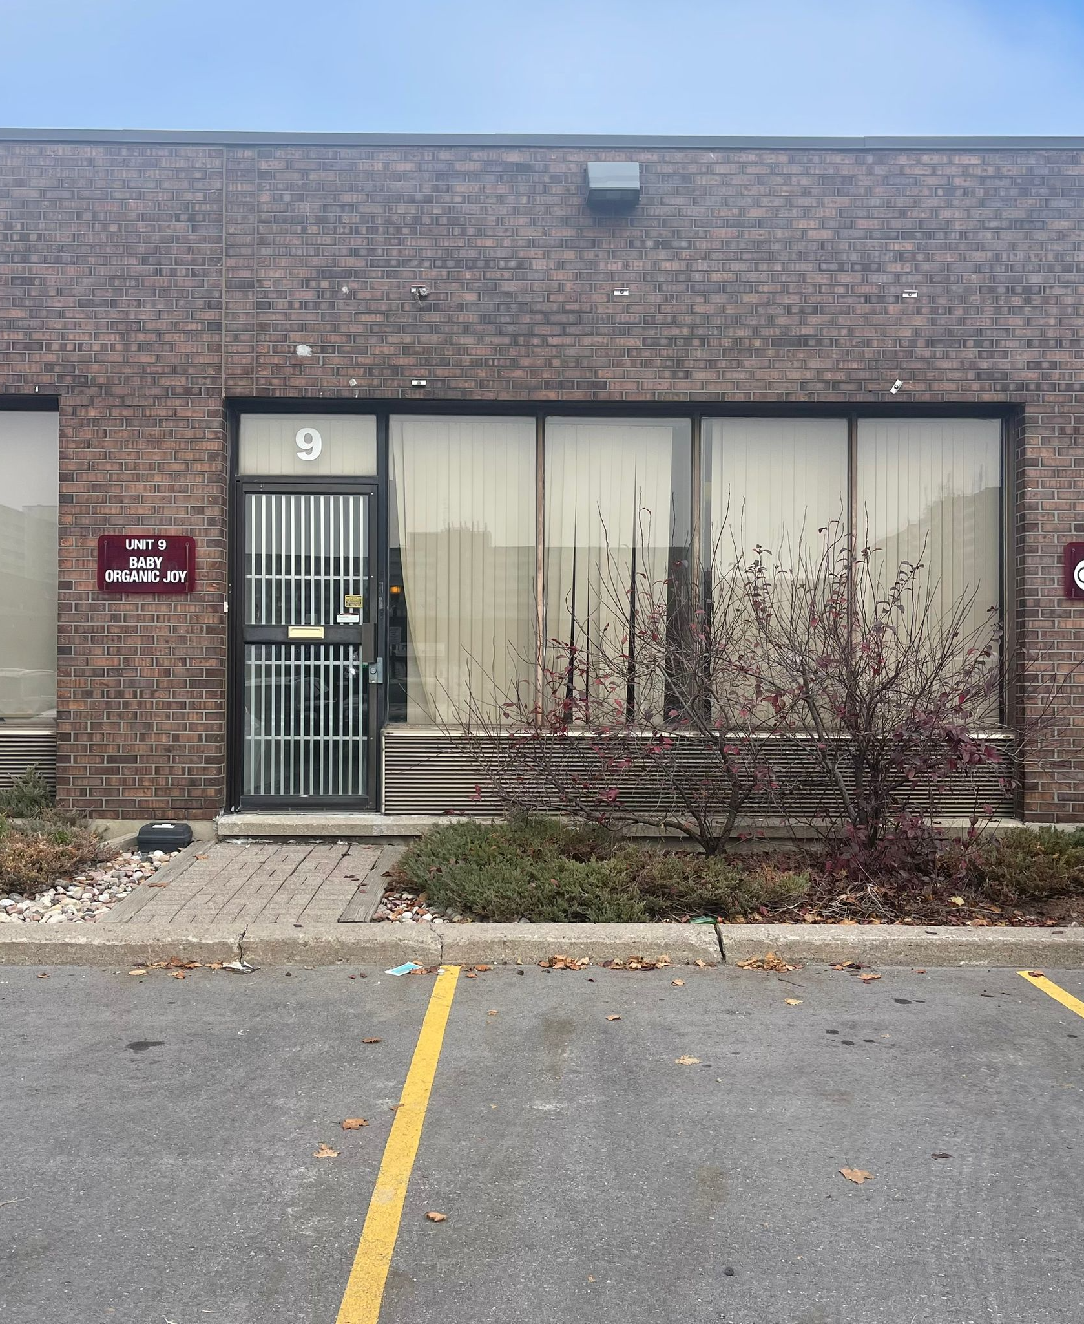
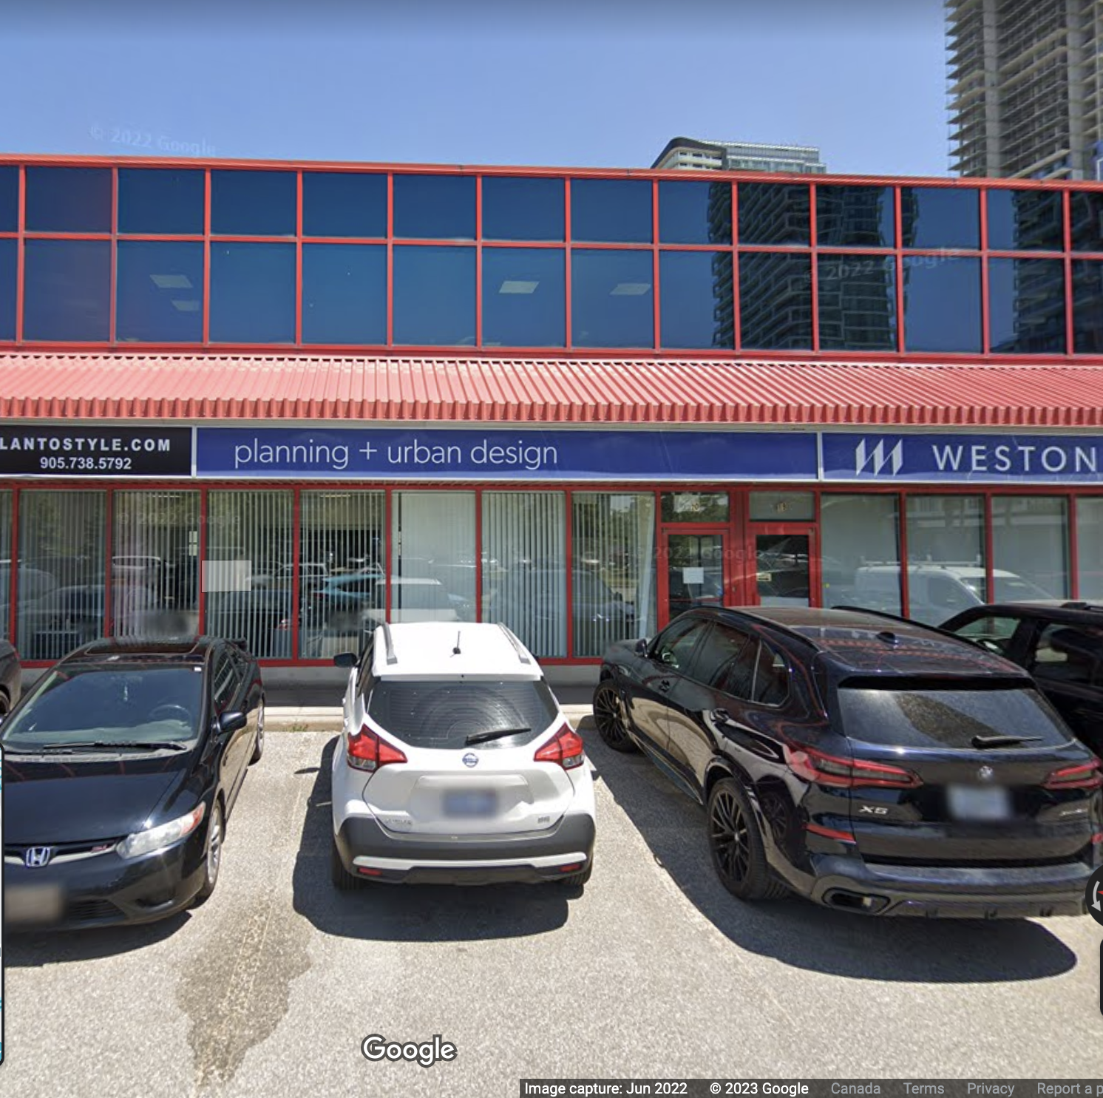









www.roycelight.com
ROYCE Lighting
Unit #9, 1200 Derry Rd E. Mississauga, ON L5T1B6
Unit #9, 31 Progress Ave.
Scarborough, ON
M1P4S6
Unit #11, 201 Milway Ave.
Vaughan, ON
L4K5K8
647 927 6923
info@roycelight.com

