Slide 1
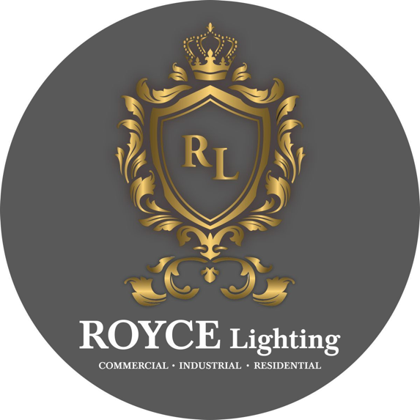
Industrial & Commercial

Slide 2
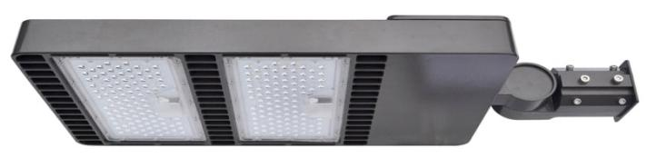
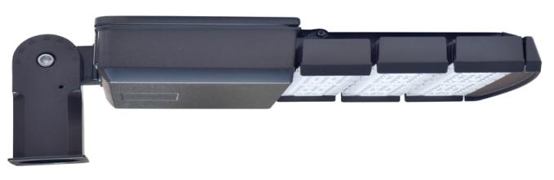
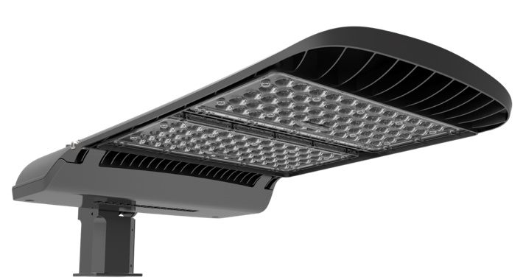
LED Exterior – LED Shoe Box Light
LED Exterior – LED Street Light

Slide 3
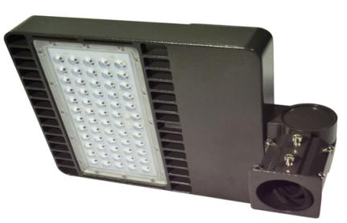
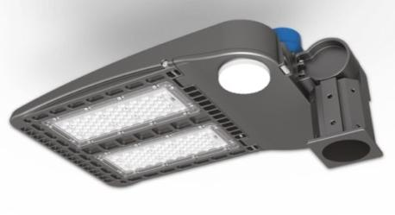

Slide 4
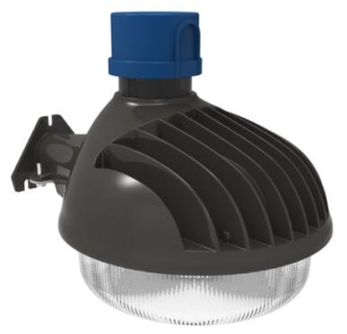
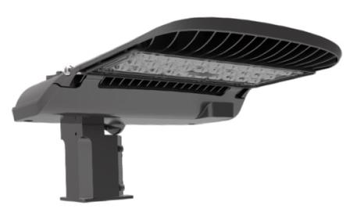

Slide 5
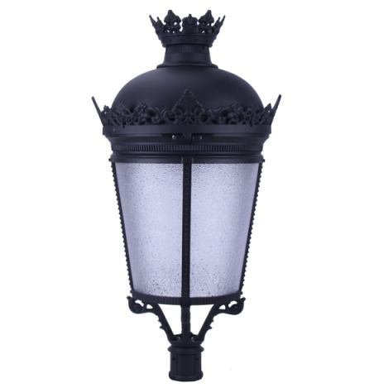
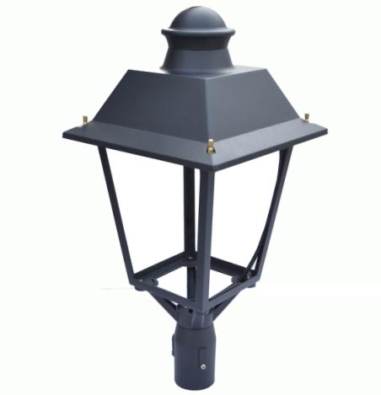

Slide 6
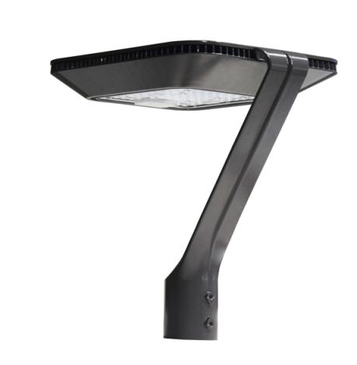
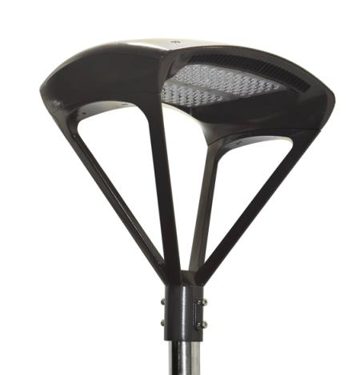
LED Exterior – LED Post Top Light
LED Exterior – LED post Top light (300W)

Slide 7
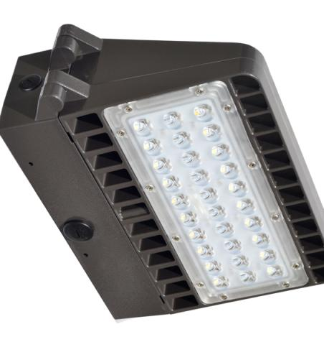
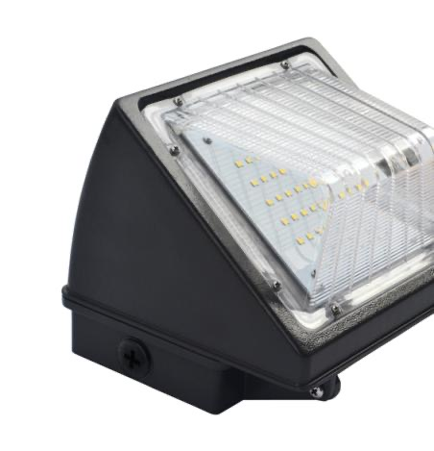

Slide 8
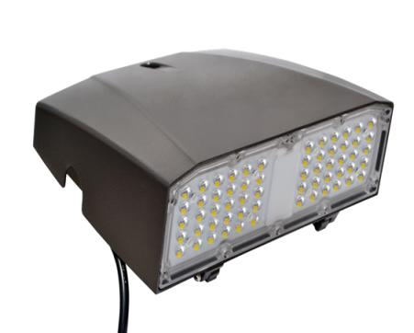
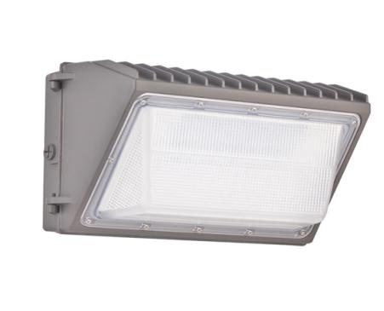
LED Exterior – Slim LED Wall Pack

Slide 9
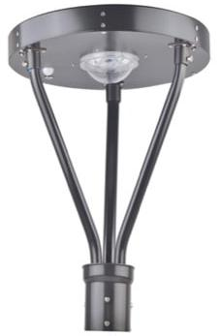
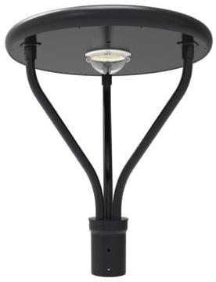
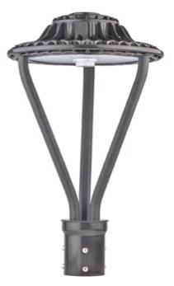

Slide 10
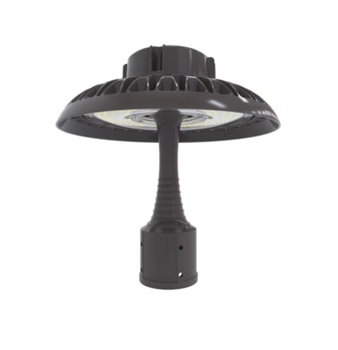
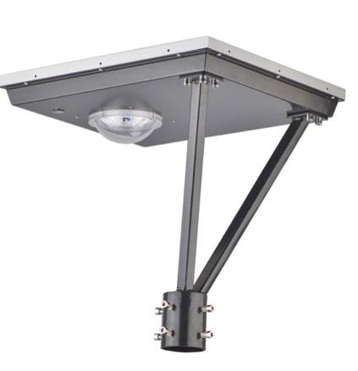

Slide 11
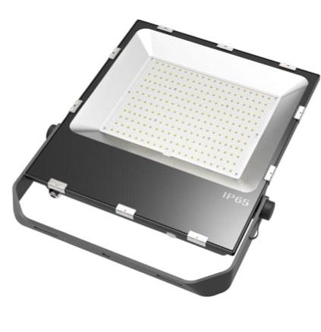
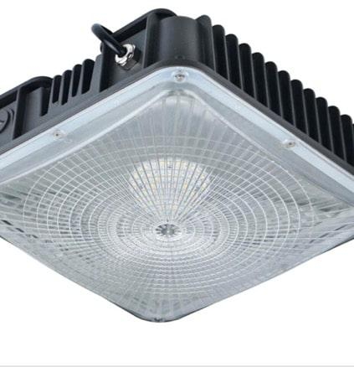

Slide 12
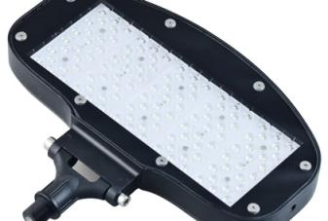
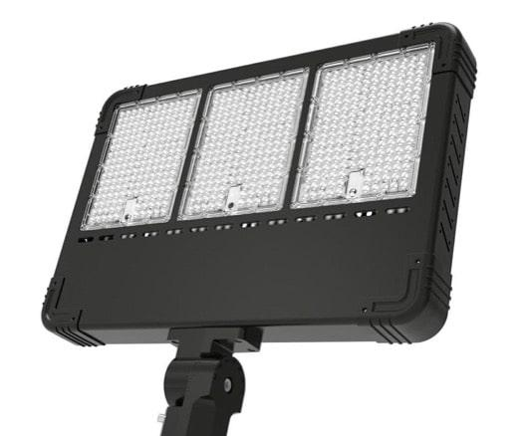
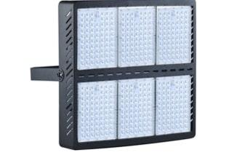

Slide 13
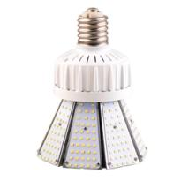
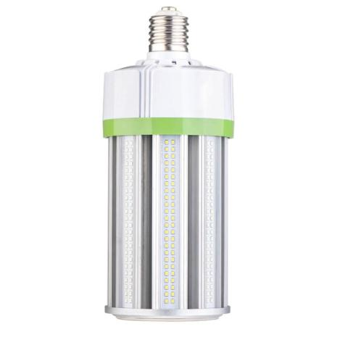
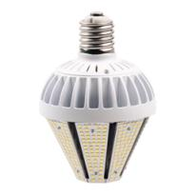

Slide 14
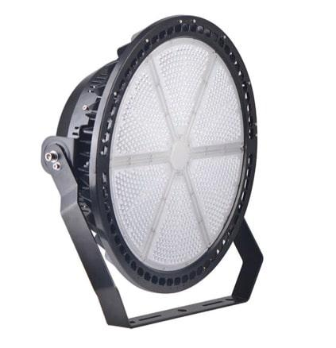
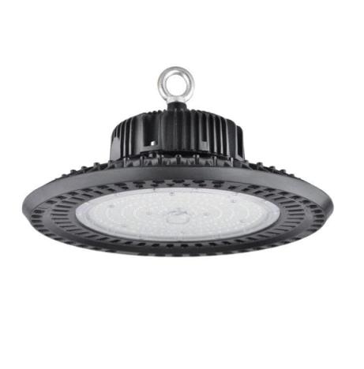

Slide 15
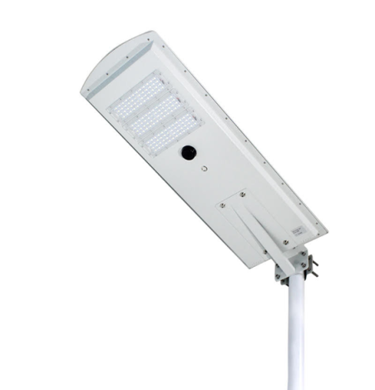
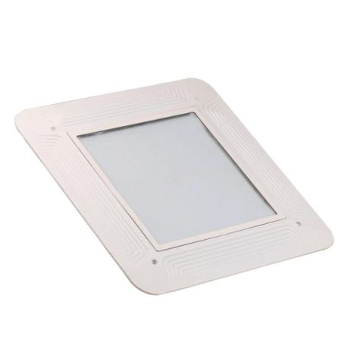

Slide 16
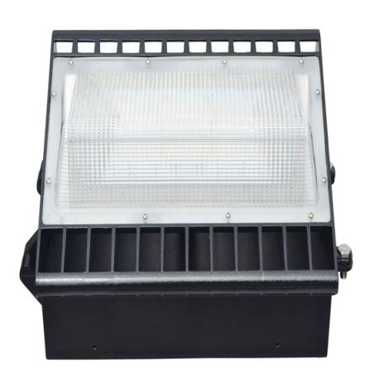
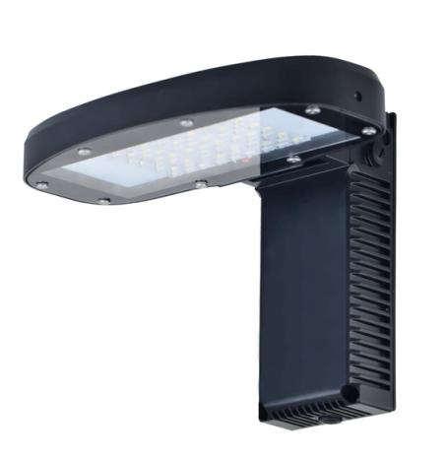
LED Exterior – LED Traditional Wall Pack

Slide 17
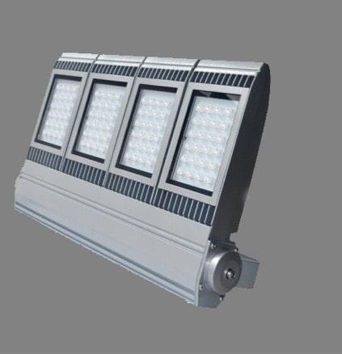
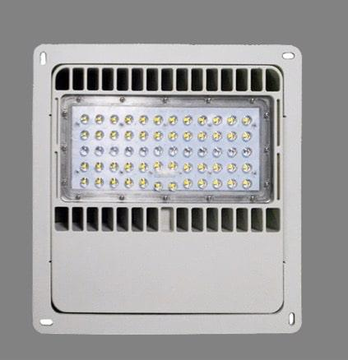
LED Exterior – LED Flood Light
LED Exterior – LED Canopy Light

Slide 18
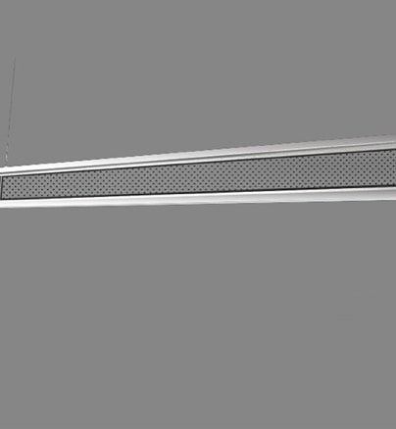
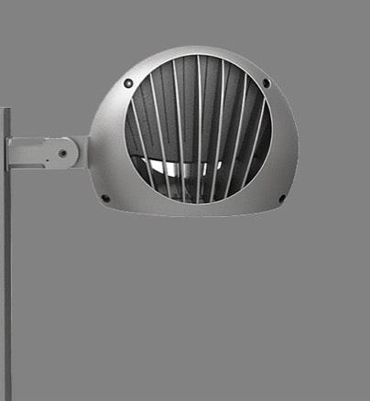
Interior LED – Vertical LED Linear Pendant Fixtures
LED Exterior – LED Ball Light

Slide 19
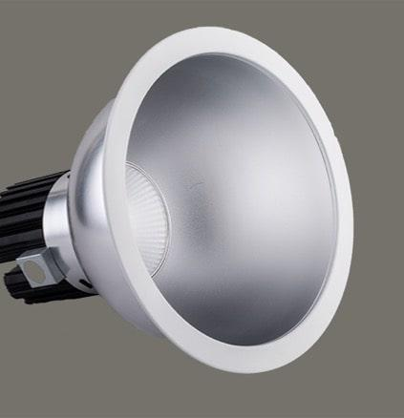
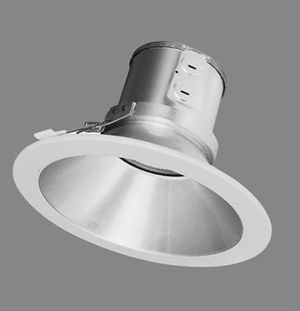
Interior LED – Commercial Downlight
Interior LED – Split Downlights

Slide 20
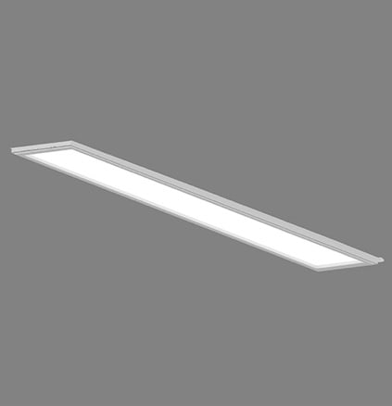
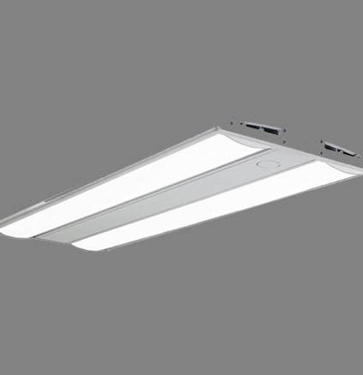
Interior LED – Air Flat
Interior LED – LED Linear Highbay Light

Slide 21
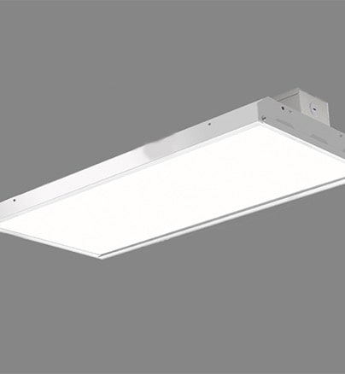
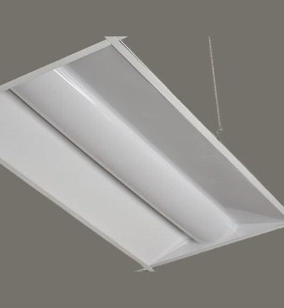
Interior LED – Linear High Bay
Interior LED – Central Basket Troffer

Slide 22
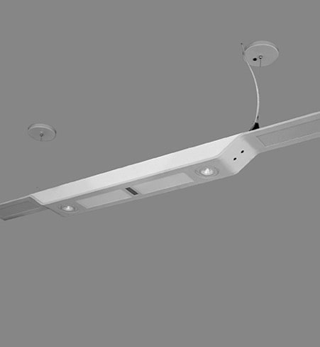
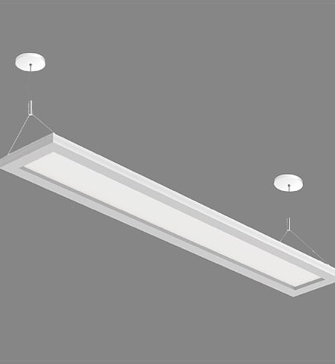
Interior LED – Architectural LED Pendant Light
Interior LED – Up Down Linear Light DP Series

Slide 23
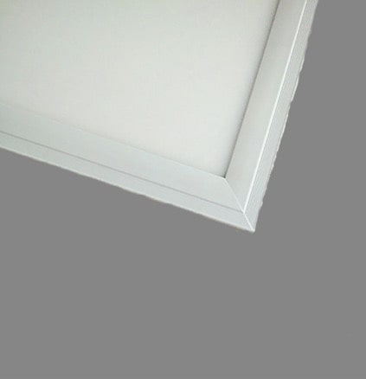
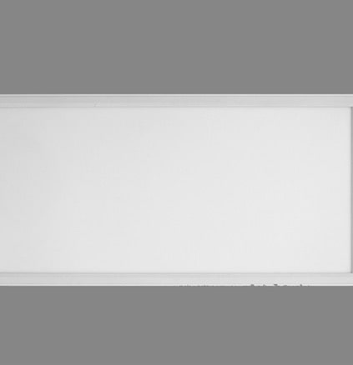
Interior LED – Recessed Flat Panels
Interior LED – Thinnest Surface Mounted

Slide 24
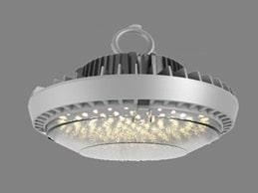


Interior LED – UFO LED High Bay Light
Interior LED – Indirect LED Troffer
Interior LED – Surface Mounted Downlight

Slide 25



Interior LED – High Voltage Emergency Led Driver
Interior LED – UL Listed
Interior LED – Split Design with Battery Pack and LED Driver

Slide 26



Slide 27













www.roycelight.com
ROYCE Lighting
Unit #9, 1200 Derry Rd E. Mississauga, ON L5T1B6
Unit #9, 31 Progress Ave.
Scarborough, ON
M1P4S6
Unit #11, 201 Milway Ave.
Vaughan, ON
L4K5K8
647 927 6923
franchise@roycelight.com

