Slide 1

Information
Deck

Slide 2
Contents
About
Lighting
Furnishing
Furniture
Mirrors
Linen
Towels
Crockery & Cutlery
Signages
Our Clients
3
4-17
18-26
27
28

Slide 3

About ROYCE
We come with an experience of about 35 years in lighting business. Royce started out as a lighting store in the neighborhood and today it is catering all sorts of requirement for Industrial, commercial and residential clients
We provide countless options ranging from classic chandeliers to contemporary shades and LED bulbs, we help find exactly what one is looking for.
Royce is also into manufacturing of etched and UV printed glass, LED mirrors using ultra modern technology and smart home systems for your home security.
Our group company Royce furnishing has a wide range of furnishing products for Hotels, Motels, resorts etc. comprising of both hard and soft furnishing, crockery, cutlery, linen, amenities.
Royce Signs exclusively manufactures signages of various sizes, quality, material both indoor and outdoor.
Our approach is to demonstrate with practicality how solutions shine through. The philosophy includes practical solutions, professional training and personalized service.
We believe in making good things happen, the way you want.
We enjoy helping our customers find the perfect solution for desired style and budget.
We are truthful and transparent in our interactions with customers.
ROYCE Lighting
ROYCE Furnishing
ROYCE Global Technologies
ROYCE Signs
Elegante Glass

Slide 4
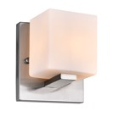
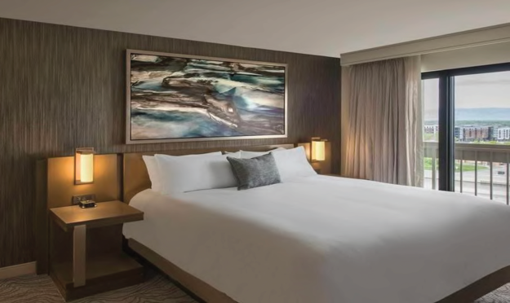
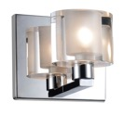
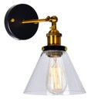
Lighting
BED SIDE LIGHTS

Slide 5

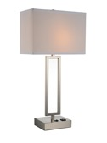
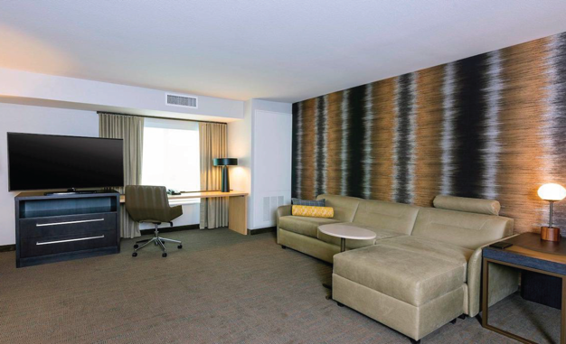
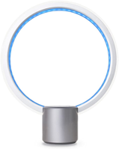
Lighting
TABLE LAMPS

Slide 6
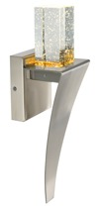
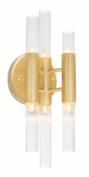
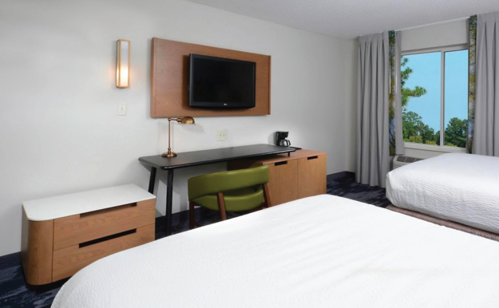
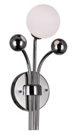

Lighting
WALL LAMPS

Slide 7
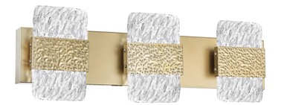
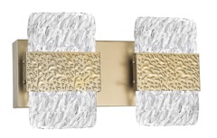
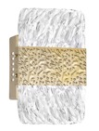
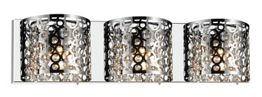
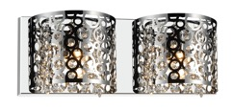
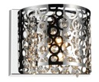

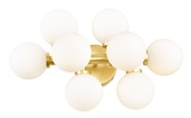
Lighting
WALL SCONCE

Slide 8
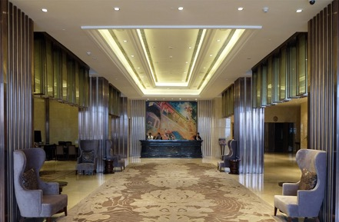
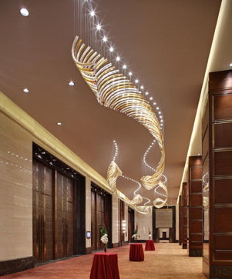
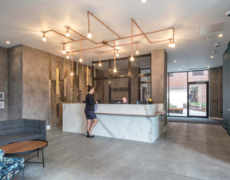
Lighting
RECEPTION & LOBBY

Slide 9
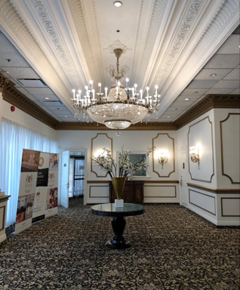
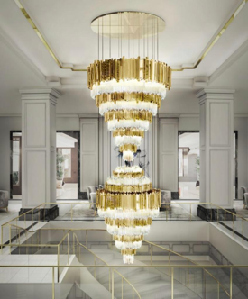
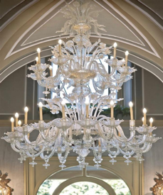
Lighting
CHANDELIER

Slide 10
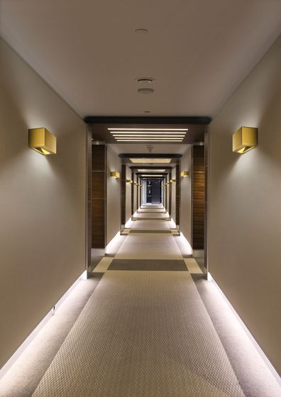
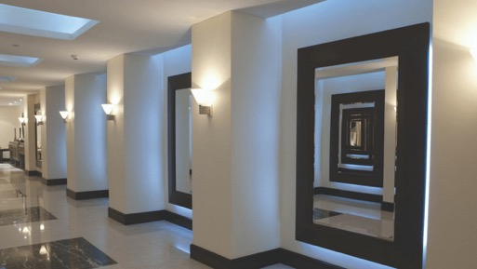
Lighting
CORRIDOR

Slide 11
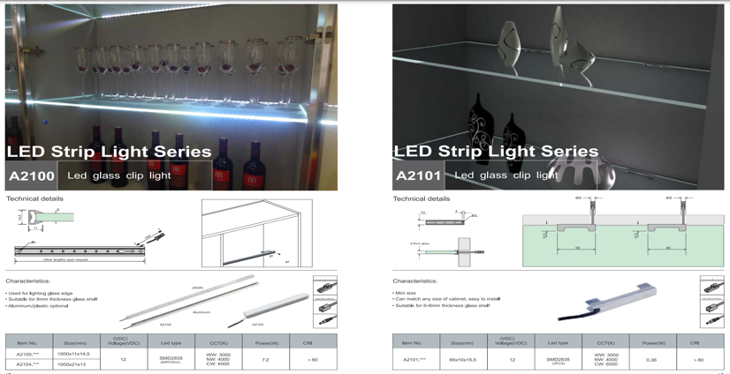
Lighting
LED STRIP LIGHTS

Slide 12
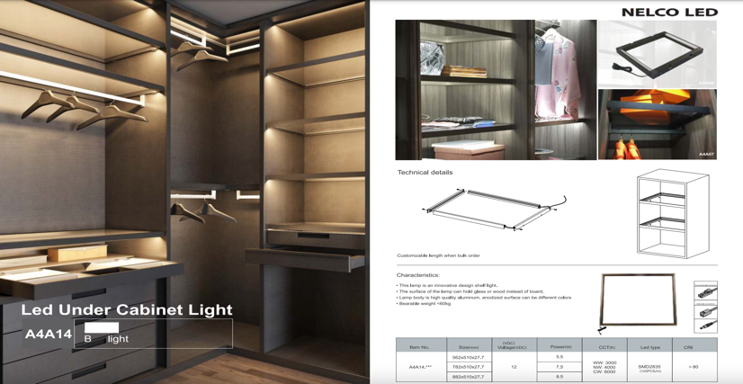
Lighting
LED STRIP LIGHTS

Slide 13
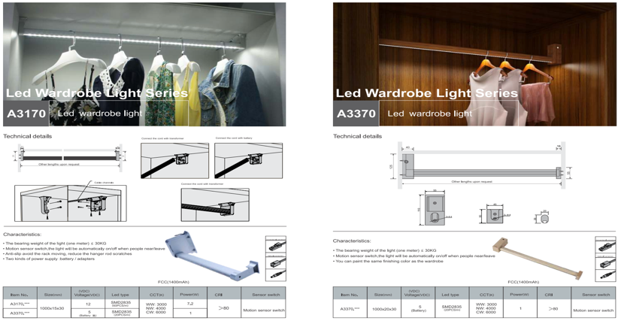
Lighting
LED STRIP LIGHTS

Slide 14
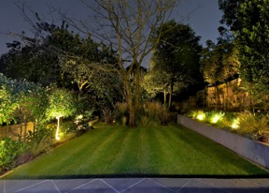
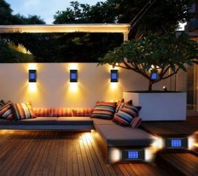
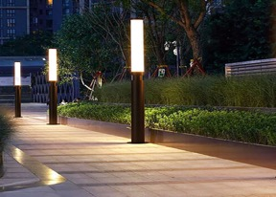
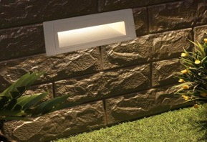
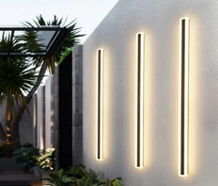
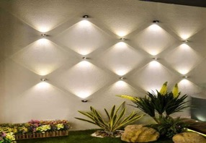
Lighting
OUTDOOR

Slide 15
Lighting
OFFICE

Slide 16
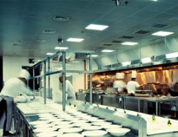
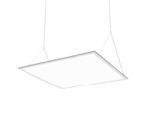

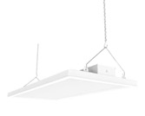
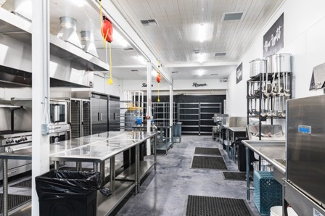
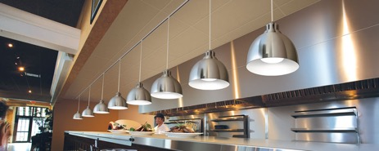
Lighting
KITCHEN & STORE

Slide 17
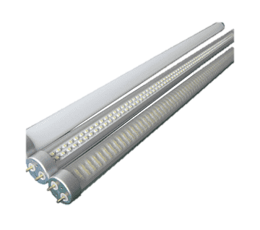
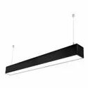





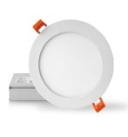
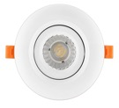
Lighting
ACCESSORIES &
SPARES
Tube Lights
Linear Lights
Bulbs
Drivers
Pot Lights

Slide 18
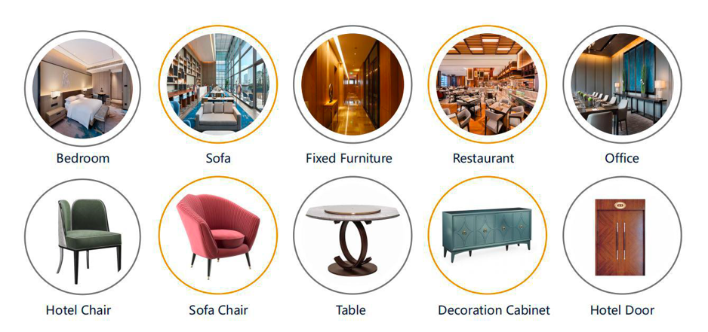
Furnishing
FURNITURE

Slide 19
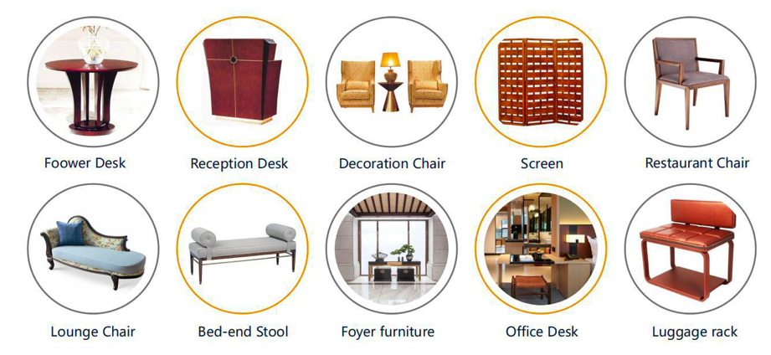
Furnishing
FURNITURE

Slide 20
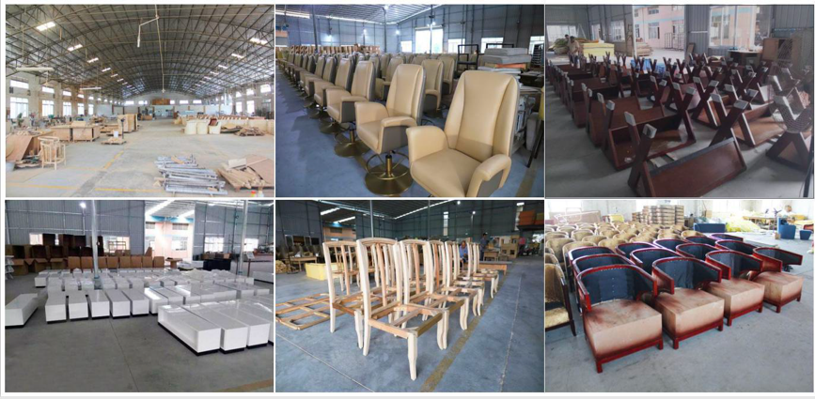
Furnishing
Production Facility

Slide 21

Furnishing
Production Facility

Slide 22
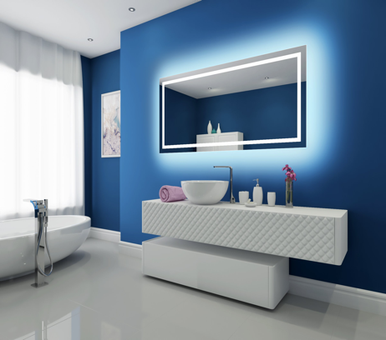
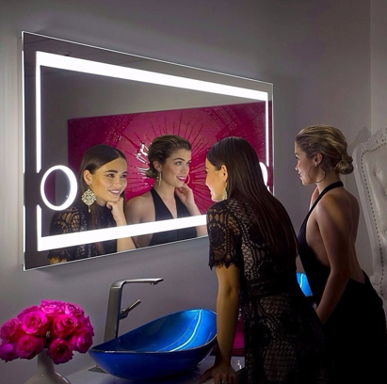
Furnishing
LED MIRRORS

Slide 23
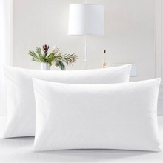




Furnishing
LINEN
Pillow
Comforter
Bed Sheets
Mattress Pad
Blankets

Slide 24




Furnishing
TOWELS
Towel
Pool / Beach Towels
Premium Color Towels
Bar Mop Towels
Premium White Towels

Slide 25






Furnishing
AMENITIES
Bath Robe
Shaving / Dental Kit
Curtains
Shampoo
Soap

Slide 26



Furnishing
CROCKERY &
CUTLERY

Slide 27





Signages

Slide 28



CLIENTS

Slide 29


ROYCE Lighting ROYCE Furnishing
9-31, Progress Ave., Scarborough, ON, M1P4S6
647-927-6923
www.roycelight.com
www.roycefurnishing.com
Thank you
All material contained in this document belong to the company and are protected under Copyright law and may not be reproduced, distributed, transmitted, displayed, published or broadcast without prior express written permission of the company.
© 2022 Royce Group

